Slide 1
Star Wars on FX Markets
Gabor Liener, Head of Capital Markets
Siófok, 03 June 2016
Notes:
Germany is a suspected currency manipulator!
And Japan, and China, and Korea, and Taiwan!
But who says that? The US Treasury in its report on foreign exchnage policies of its major trading partners
And the US Treasury puts Germany, Japan, China, Korea and Tiwan on MONITORING LIST due to their Foreign Exchange policies!
Why are they on the list?
siginificant trading surplus with the US,
material current account surplus,
The report also says that they did NOT engage in PERSISTENT one-sided intervention in the foreign exchange markets.
Still, the US Treasury puts the above countries on its Monitoring list due to their Foreign Exchange policies!
It does not sound very friendly, does it?
But is this a curreny war?

Slide 2
Long time ago in a galaxy far far away…
…there were no QE and zero interest rates.
So how and why did it start?
Notes:
But let me start from the beginning! Long time ago in a galaxy far far away there was no QE, neither zero interest rates.

Slide 3
Post-Financial Crisis
Low growth
No inflation
Budget deficits
Public debt
Need a solution…
Notes:
After the financial crisis we left with many problems
Low growth: according to OECD latest report the World GDP growth rate decreased from 5% to below 3%, and expects little acceleration to 3,5%
There is no or very little inflation. Core CPI is around 2% in the US, but around 1% in Euro Zone, fell back below 0% in Japan. In China 1,5%
While public debt to gdp increased from end of 2007 till today
USA from 62% to 102%
UK from 43% to 90%
EUR area from 65% to 90%
Japan 170% to 228%
Need a solution!

Slide 4
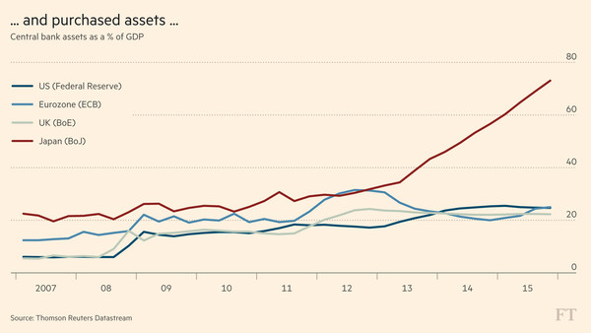
Central Banks: Zero rates and QE
Notes:
But due to the financial crises, and its consequences
Central banks cut interest rates to zero and started agressive asset purchase programms
The FED’s balance sheet increased 3 times comapred to GDP
The ECB balance sheet increased doubled and the ECB still buys EUR 80 billion asstes per month
The Bank of Japan’s balance sheet ballooned to 70% compared to GDP
Why did they do it?
To stimulate consumption
To stimulate new investments through cheaper long term refinancing rates
To increase inflation to their target levels
And to weaken their currencies in competitive devaluation…

Slide 5
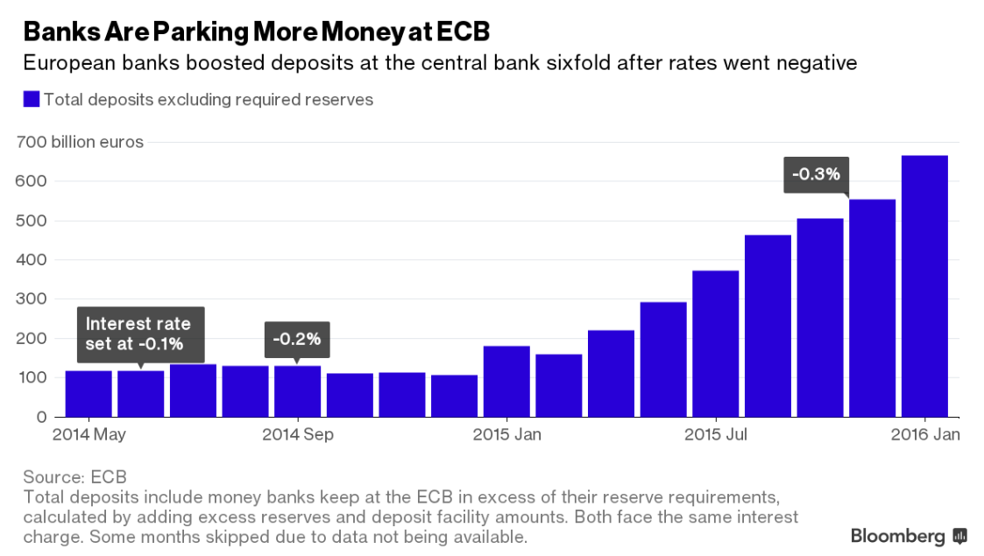
Corporate credit is recovering… slowly…
Notes:
European banks are parking deposits six fold with ECB after rates went negative
In the largest EUR countries corporate credit growth is starting to go back to positive

Slide 6
Is money printing a zero sum game?
Notes:
But back to the original question: Is there a currency war out there?
To answer this question we should try to answer the following question first: Is money printing a zero sum game?
Some economist strongly believe that it is, because if one currency depreciates then another will simultanuously appreciate, hence it must be a zero sum game.
Other economists say that money printing helps the economy via credit channels, consumption, and lower debt burden.
BUT competitive devaluation have impacts which are not so obvious.
Take the dollar as an example:
Common sence says that strong dollar helps the rest of the World with better export opportunities. But now many economists argue that a strong dollar is a big burden on Asian countries, as they are heavily indebted in USD. If the strong dollar hurts these countries due to corporate defaults then it will have negative consequences on the World economy, and throughout this to Europe as well.
There are different views. Kocherlakota, Minneapolis FED president between 2009-2015 says that the strong dollar would not hurt the US for two reasons:
FED could cut rates again if dollar appreciation hurts the US economy
Globally traded goods are priced in USD, and those products prices’ do not change much with currency fluctuations, hence USD appreciation does not hurt US, while helps other G7 nations
Anyway, there are many different views out there, the only thing we cannot deny is someting is going on under the surface.

Slide 7
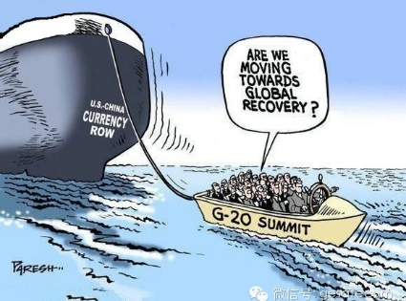
G20: „monetary policy alone cannot lead to balanced growth”
Notes:
In February, G20 leaders spoke about the need to refrain from currency competitiveness, marked an agreement to stabilize FX movements for the sake of calming a market turning over trillions of dollars each day. They also told that monetary policy alone cannot lead to balanced growth. Sounds like a good start! I hope they will define the next steps soon and the currency war is over. Or not?

Slide 8
May the force be with… Usd? EUR? GBP?
Notes:
But back to the original question: Is there a currency war out there?
To answer this question we should try to answer the following question first: Is money printing a zero sum game?
Some economist strongly believe that it is, because if one currency depreciates then another will simultanuously appreciate, hence it must be a zero sum game.
Other economists say that money printing helps the economy via credit channels, consumption, and lower debt burden.
BUT competitive devaluation have impacts which are not so obvious.
Take the dollar as an example:
Common sence says that strong dollar helps the rest of the World with better export opportunities. But now many economists argue that a strong dollar is a big burden on Asian countries, as they are heavily indebted in USD. If the strong dollar hurts these countries due to corporate defaults then it will have negative consequences on the World economy, and throughout this to Europe as well.
There are different views. Kocherlakota, Minneapolis FED president between 2009-2015 says that the strong dollar would not hurt the US for two reasons:
FED could cut rates again if dollar appreciation hurts the US economy
Globally traded goods are priced in USD, and those products prices’ do not change much with currency fluctuations, hence USD appreciation does not hurt US, while helps other G7 nations
Anyway, there are many different views out there, the only thing we cannot deny is someting is going on under the surface.

